Slide 1

MONEY LAUNDERING DETECTION USING MACHINE LEARNING METHODS
Date: 23 April 2021
K.THANMAI : 17WH1A0513
G.SRIVIDYA : 17WH1A0534
G.NYMISHA : 17WH1A0530
Internal Guide: Mr. K.NARESH
Designation: Assistant Professor
Department of Computer Science & Engineering
BVRIT HYDERABAD College of Engineering for Women

Slide 2

Project Introduction
Why Should I Study this course?
Examples
Domain:
Datamining, ML
Abstract:
Money laundering is the process of taking cash earned from illicit activities such as drug trafficking, and making the cash appears to be earnings from a legal business activity. The money from the illicit activity is considered dirty and the process “launders” the money to make it look clean.
1
BVRIT HYDERABAD College of Engineering for Women

Slide 3
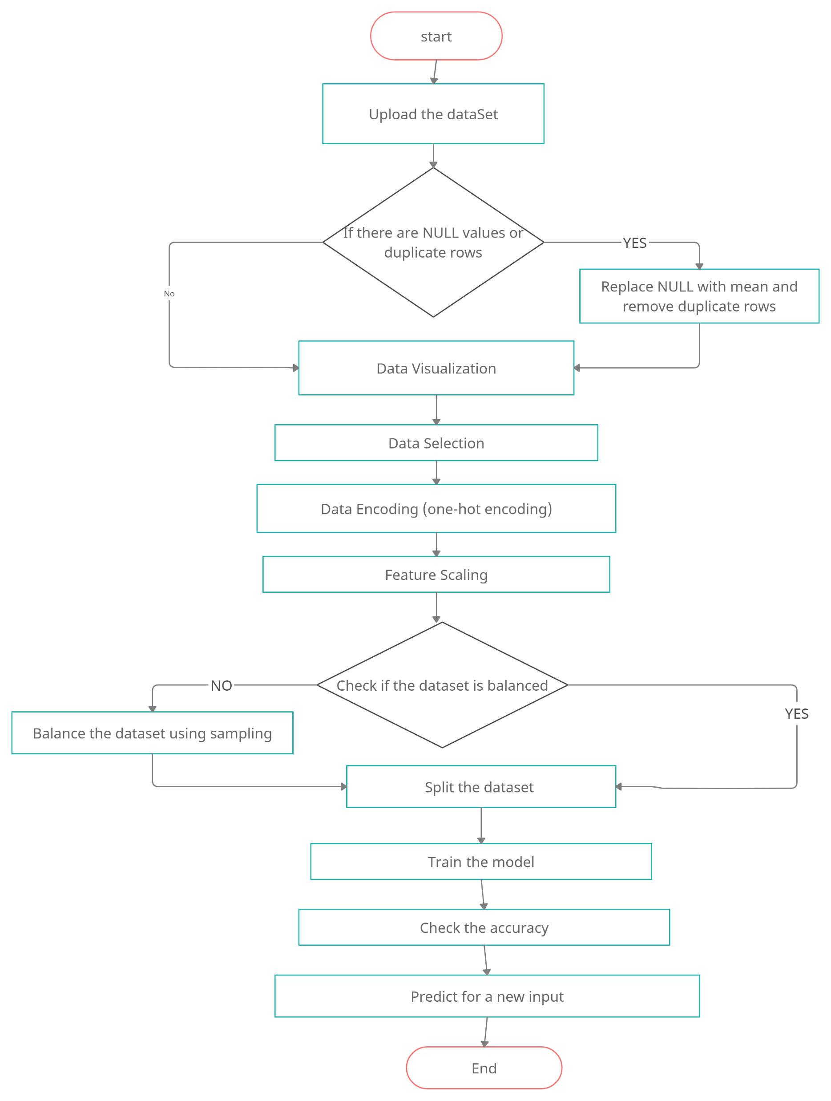
DESIGN AND WORKFLOW

Slide 4
TECHNOLOGY STACK
Machine Learning
Tkinter
Python Programming Language
Anaconda - Jupyter notebook
Required Python Packages:
numpy
pandas
keras
sklearn
tkinter
matplotlib
Imblearn

Slide 5
PROGRESS MADE AND FUTURE WORK
PROGRESS:
Completed data preprocessing
Completed feature scaling and data encoding
Completed sampling
FUTURE WORK:
Algorithms to be used:
Decision tree
Random Forest
Linear Regression
Classifying a new input

Slide 6
SYSTEM SPECIFICATIONS
ENVIRONMENT | SPECIFICATIONS
HARDWARE | Processor – i5 Processor Memory(RAM) - 4 GB and more
SOFTWARE | Python3 OS - Windows 10 Anaconda-Jupyter notebook
3

Slide 7
References
Base Paper:
https://www.ripublication.com/ijaer17/ijaerv12n20_120.pdf
Reference Papers:
http://www.ijarset.com/upload/2015/august/1_IJARSET_manjunath.pdf
https://www.researchgate.net/publication/43508814_Knowledge-based_anti-money_laundering_A_software_agent_bank_application
4

Slide 8
Thankyou
5
BVRIT HYDERABAD College of Engineering for Women

